Slide 1
Credit Risk Analysis
Assignment Presentation
36100 Data Science for Innovation - Autumn 2024
Group Name: Orion

Slide 2
Members
Shaqran Bin Saleh ID: 25010238
Al Jobyer Swajoy ID: 25389483
Hasnaine Ahmed Dihan ID: 25382363
Masuma Tasnim Jerin ID: 25097799
Md Eusuf Ali Rinku ID: 25215411

Slide 3
Problem Description
Credit risk analysis focuses on evaluating the likelihood that a borrower will default on their loan obligations.
This analytical process is crucial for financial institutions as it directly impacts their decision-making regarding loan approvals and interest rates. By examining various borrower characteristics such as credit history, income, and loan details, analysts can identify potential risk factors.
The goal is to minimize financial losses by accurately predicting which borrowers are likely to default. Effective credit risk analysis not only protects the lender but also ensures a healthier credit market by promoting responsible lending practices.

Slide 4
Objective
Analyze the interplay between borrower characteristics and loan default risk using a comprehensive credit risk dataset.

Slide 5
Research Questions
What is the impact of the age of individuals on loan defaults?
What is the impact of the homeownership of individuals on loan defaults?
What is the impact of the annual income of individuals on loan defaults?
What is the impact of the loan grade of individuals on loan defaults?
What is the impact of the credit history length of individuals on loan defaults?

Slide 6
Literature Review
Author | Title | Source | Findings
Kolapo, T. F. (2012) | Credit risk and commercial banks’ performance in Nigeria: A panel model. | Australian Journal of Business and Management Research, 31-38. | Credit risk consistently has an impact on bank performance.
Poudel, R. P. (2012) | The impact of credit risk management on financial performance of commercial banks in Nepal. | International Journal of Arts and Commerce. | There is significant inverse relationship found.

Slide 7
Literature Review
Author | Title | Source | Findings
Kithinji, A. M. (2010) | Credit risk management and profitability of commercial banks in Kenya. |  | Credit risk management may have led to a decrease in non performing loans.
Boahene SH, D. J. (2012) | Credit risk and profitability of selected banks in Ghana. | Research journal of finance and accounting. | Ghanaian banks have significant profitability during periods of elevated credit risk parameters.

Slide 8
Literature Review
Author | Title | Source | Findings
Million GIzaw, M. K. (2015) | The impact of credit risk on profitability performance of commercial banks in Ethiopia. | African Journal of Business Management, 59-66. | Many practical studies show negative and significant association between credit risk and the performance of commercial banks.

Slide 9
Approach
Data Preparation
Correlation and Hypothesis Testing : Some variables show more promise than others in predicting the target variable. The Correlation analysis helps refine the features to include in the predictive models. And for Hypothesis Testing, we performed the testing using Chi_square Statistics and Kruskal-Wallis-Test.
Machine Learning Models and Evaluation:
Logistic Regression: Deploy this model to predict the probability of default based on borrower data, providing a straightforward and interpretable output.
Decision Tree Classifier: Use this model to handle complex, non-linear relationships and to identify the key thresholds that split borrower categories distinctly based on risk.
Our objective is to combine traditional statistical methods and advanced machine learning techniques to improve the accuracy of credit risk predictions, aiding in the decision-making process for loan approvals.

Slide 10
Data Exploration
The dataset you've opted for, containing over 32,000 records, seems well-equipped for a thorough credit risk analysis. Each of the 12 distinct features you've listed plays a significant role in understanding and predicting loan defaults. Here's a brief summary of how these features can be utilized in your analysis:
Person Age: Understanding the age distribution can help identify if younger or older individuals pose a higher risk.
Annual Income: This is crucial for assessing the borrower's ability to repay the loan.
Home Ownership: Indicates stability and financial health of the borrower.
Employment Length: Longer employment may imply a lower risk of default.
Loan Intent: The purpose of the loan could be linked to different levels of risk.
Loan Grade: Typically reflects the quality of the loan and the borrower’s creditworthiness.
Loan Amount: Higher amounts might be riskier, depending on the borrower's financial profile.
Interest Rate: Higher rates often correlate with higher risk.
Loan Status: Your primary variable of interest, indicating whether the loan has defaulted.
Percent Income: The loan amount as a percentage of income, a key indicator of debt burden.
Historical Default: Past default history is a strong predictor of future risk.
Credit History Length: Longer credit history might indicate more reliable borrowers.

Slide 11
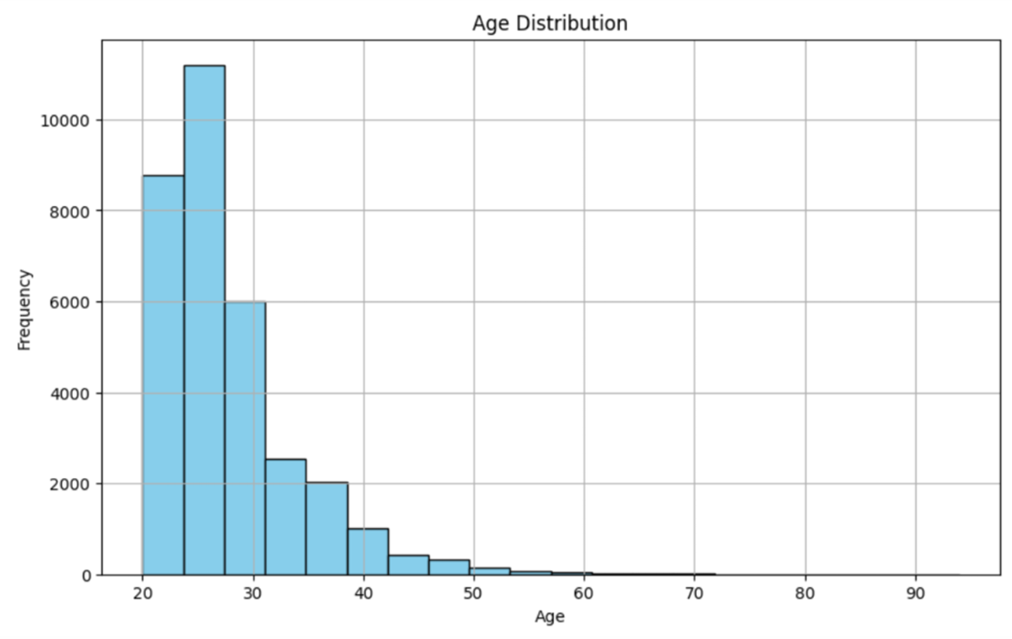
Age Distribution

Slide 12
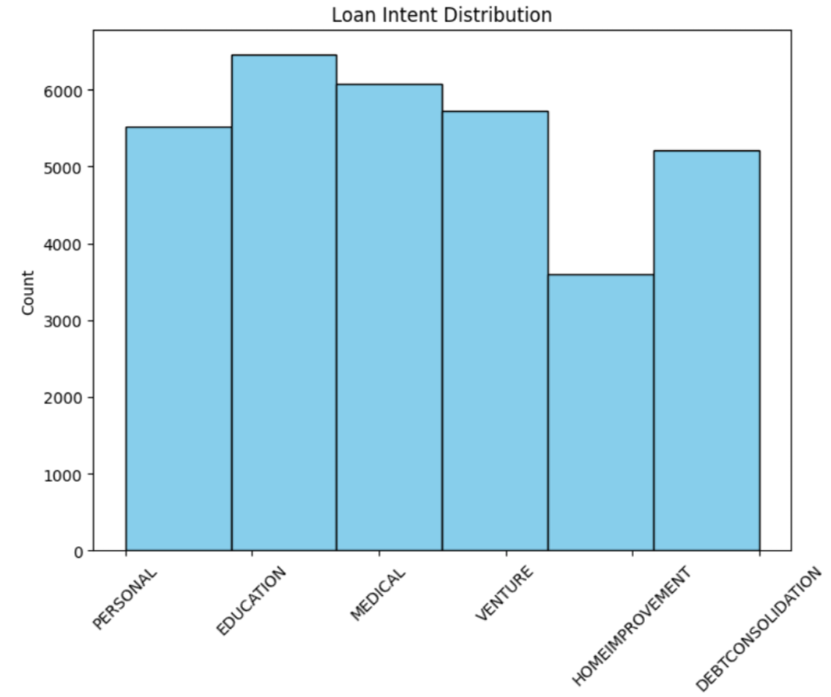
Loan Intent Distribution

Slide 13
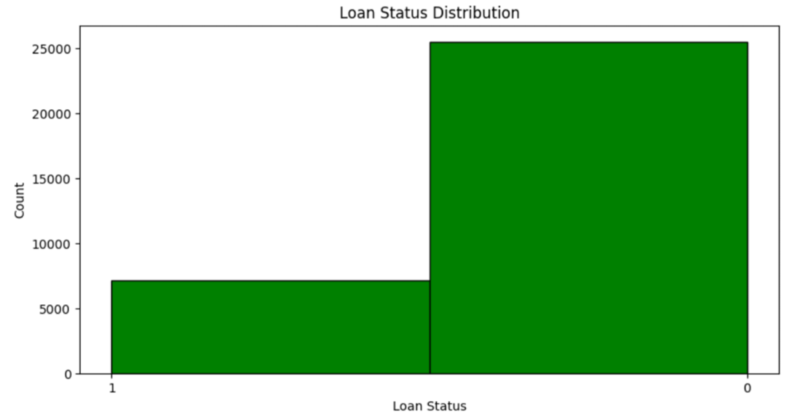
Loan Status Distribution

Slide 14
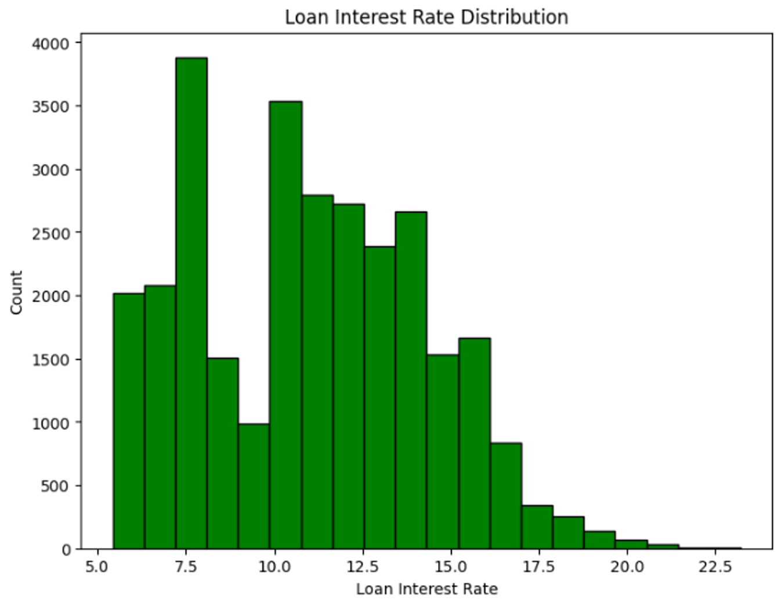
Loan Interest Rate Distribution

Slide 15
Hypothesis Testing

Slide 16
Correlation Analysis
Our analysis of the correlation matrix reveals several key insights into the relationship between loan status and borrower characteristics.
Person_home_ownership shows a moderate positive correlation with loan status.
Loan grade exhibits a similar trend, with a moderate positive correlation to loan status.
Interestingly, age and credit history length display a very weak negative correlation with loan status, indicating minimal influence.
However, a very strong positive correlation exists between age and credit history length, implying that older individuals tend to have established credit histories.
Finally, a moderately negative correlation between homeownership and income is observed. This suggests that individuals with higher incomes may be less likely to own homes, potentially reflecting lifestyle preferences or demographic trends, such as a higher prevalence of renting in urban areas.
While these findings provide a foundation for understanding how borrower characteristics are linked to loan status, further investigation is necessary.

Slide 17
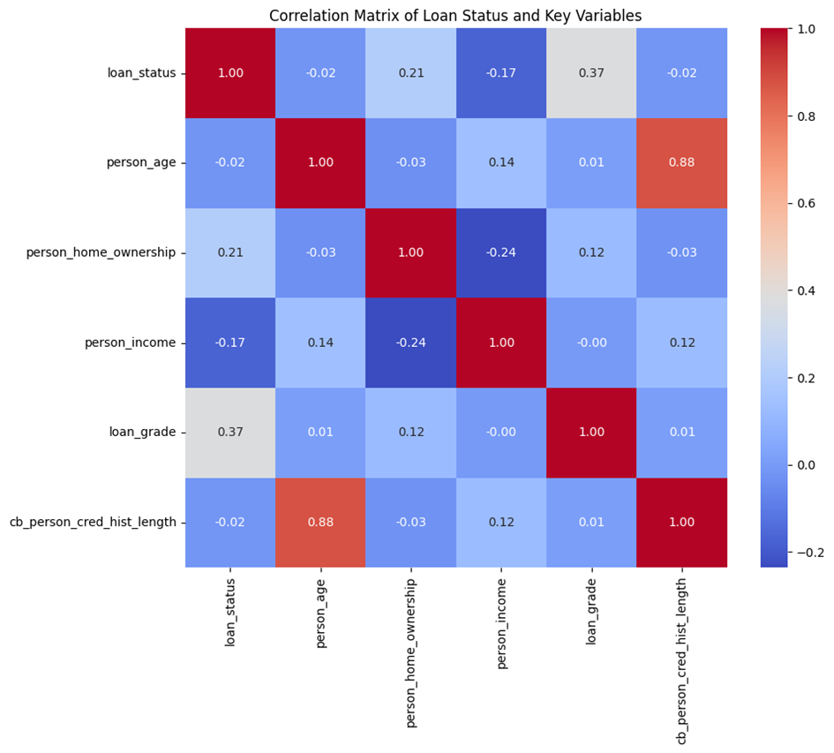

Slide 18
Machine Learning Model Deployment

Slide 19
Logistic Regression
This model was implemented as the benchmark model due to its widespread use and effectiveness in binary classification scenarios, such as predicting whether a loan will default or not.
Logistic Regression is particularly beneficial for its interpretability and the ease with which it handles binary outcomes.
The best hyperparameters, determined through Grid Search, were a regularization strength (`C`) of 1 and a penalty type of `l2`. This configuration helps balance model complexity and generalization, preventing overfitting while maintaining a decent predictive capability.

Slide 20
Decision Tree Classifier
Chosen for its ability to handle complex, non-linear relationships between features, the Decision Tree serves as a complementary model to the Logistic Regression.
It can uncover interactions and hierarchies between variables that logistic regression might miss.
The model was optimized with a `gini` criterion for split quality measurement, a maximum depth of 6 to control for overfitting, and a `best` strategy for choosing splits, which are the optimal settings found via Grid Search.

Slide 21
Machine Learning Model Evaluation

Slide 22
Logistic Regression
Logistic Regression performed well in identifying borrowers who would likely repay their loans (non-defaulters). It achieved a high success rate (precision) of 89% for this group and a good ability to find most non-defaulters (recall) at 95%. However, the model struggled to accurately predict borrowers at high risk of default. The success rate (precision) for defaulters was lower at 77%, and it missed a significant portion of defaulters (recall) at only 55%.

Slide 23
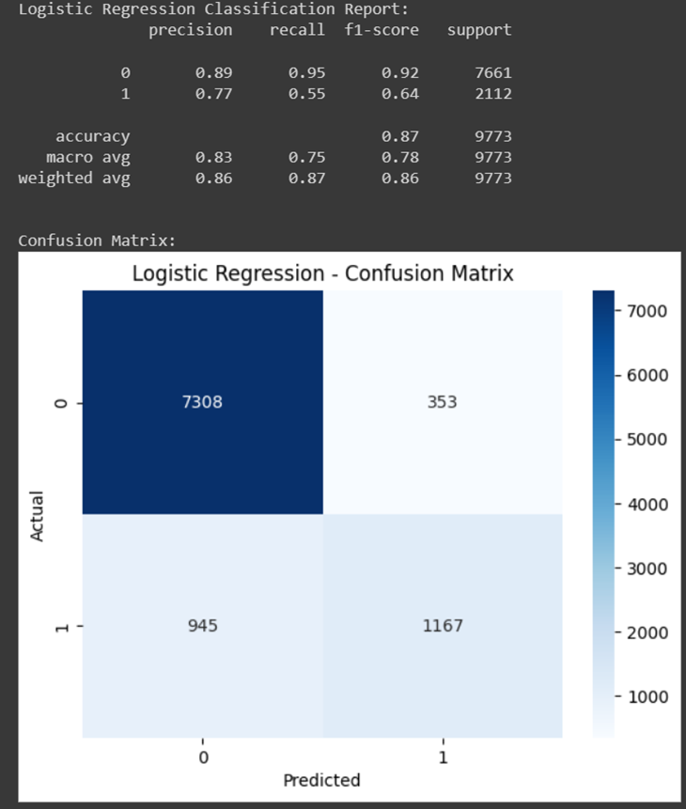

Slide 24
Decision Tree Classifier
Decision Tree Classifier showed promise, particularly after fine-tuning its settings (hyperparameter optimization). Overall accuracy improved to 92%, indicating a more robust model. The ability to identify non-defaulters remained strong with a success rate (precision) of 92% and a high likelihood of finding most non-defaulters (recall) at 99%. Importantly, the optimized model significantly improved its ability to pinpoint defaulters, achieving a success rate (precision) of 94%. There was a slight trade-off, with a small decrease in finding all defaulters (recall) from 77% to 67%.

Slide 25
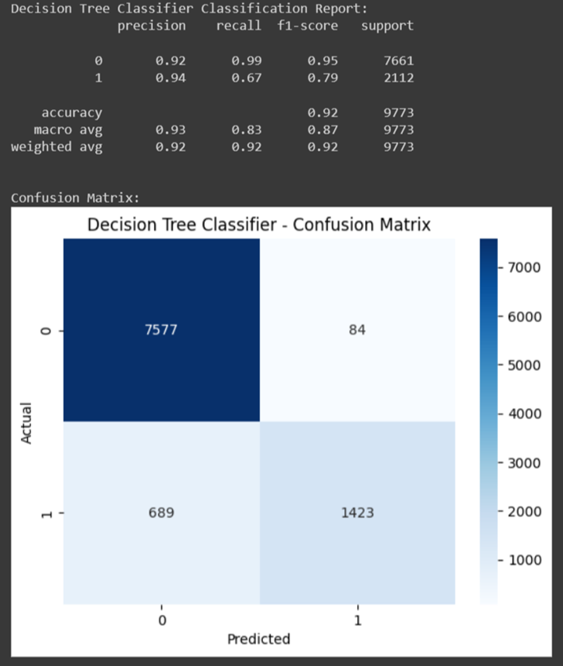

Slide 26
Limitations
Data Challenge :
Both models struggled with the uneven distribution of classes, specifically the underrepresentation of loan defaulters. This imbalance made it difficult to accurately predict defaults. Decision trees, in particular, showed a decrease in their ability to identify defaulters (recall) even after adjustments.
Model Constraints:
Logistic regression, due to its basic structure, may not be able to capture complex relationships between factors that influence loan default.
Decision trees, while flexible, are prone to overfitting the training data. This was addressed to some extent by adjusting the model parameters (hyperparameter tuning), but it remains a potential limitation.
Error Pattern:
Logistic regression tended to incorrectly classify defaulters as non-defaulters (false negatives). This suggests a bias towards predicting the more frequent outcome (majority class).
Decision trees, despite improvements, also made a significant number of false negative errors, hindering their ability to accurately identify defaulters.

Slide 27
Conclusion

Slide 28
References
Boahene SH, D. J. (2012). Credit risk and profitability of selected banks in Ghana. Research journal of finance and accounting.
Kithinji, A. M. (2010). Credit risk management and profitability of commercial banks in Kenya.
Kolapo, T. F. (2012). Credit risk and commercial banks’ performance in Nigeria: A Panel Model . Australian Journal of Business and Management Research, 31-38.
Million GIzaw, M. K. (2015). The impact of credit risk on profitability performance of commercial banks in Ethiopia. African Journal of Business Management, 59-66.
Poudel, R. P. (2012). The impact of credit risk management on financial performance of commercial banks in Nepal. International Journal of Arts and Commerce.

